Slide 1


Slide 2
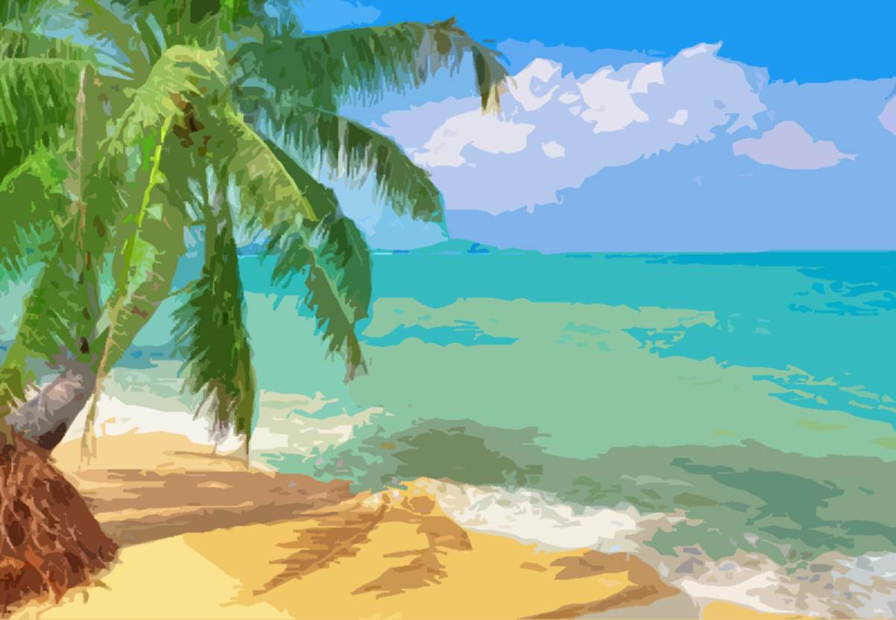







Slide 3

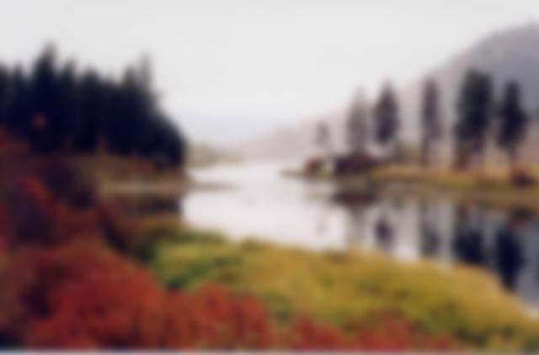

Slide 4
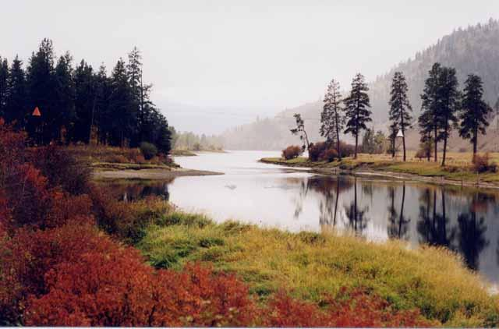
It’s a river

Slide 5


Slide 6
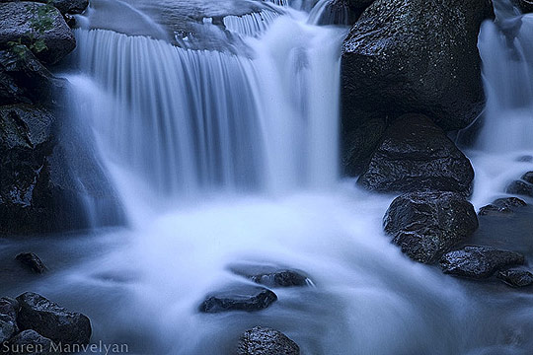
It’s a waterfall

Slide 7


Slide 8
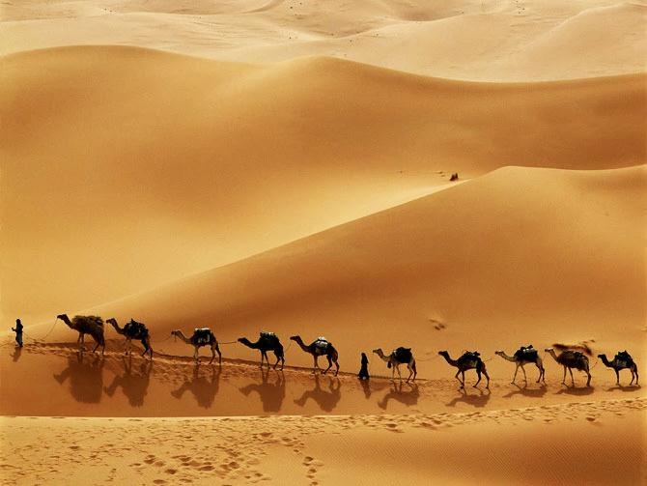
It’s a desert

Slide 9
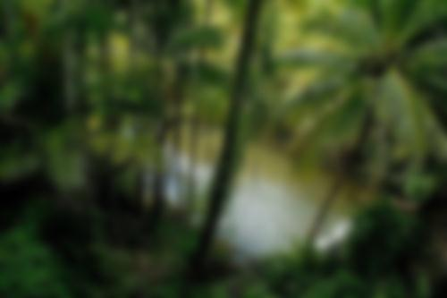


Slide 10
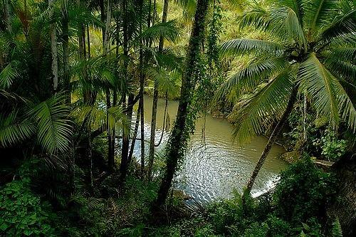

It’s a jungle

Slide 11
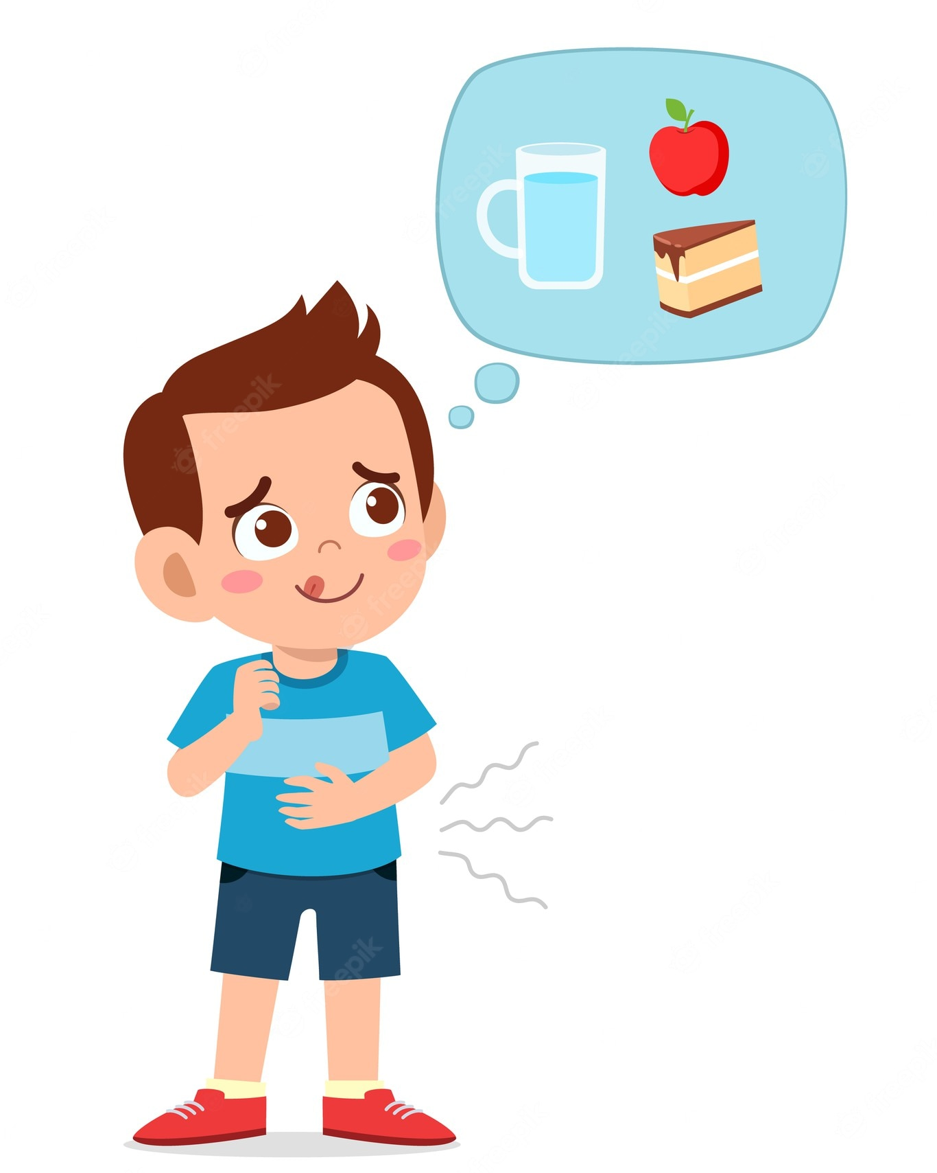
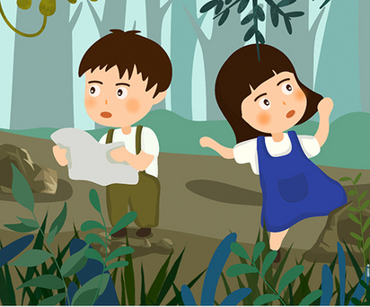
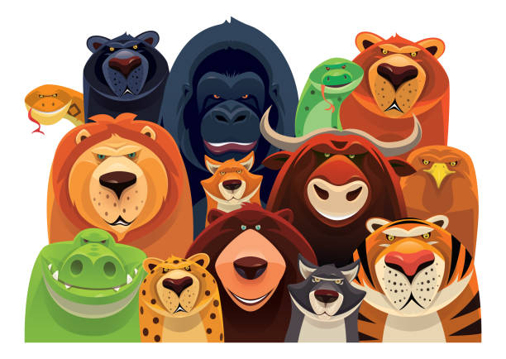
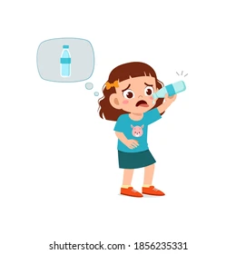
You are lost in the jungle. Name 3 problems you face.

Slide 12

UNIT 6
SURVIVAL
LESSON 1: VOCABULARY
Survival verbs

Slide 13


Slide 14

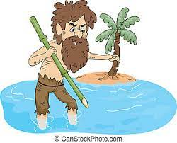
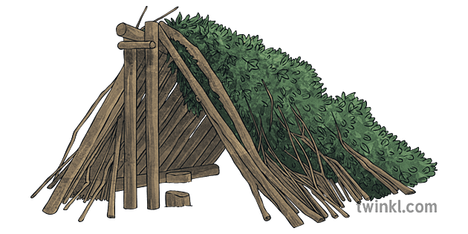
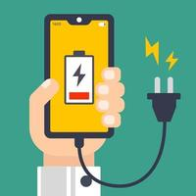
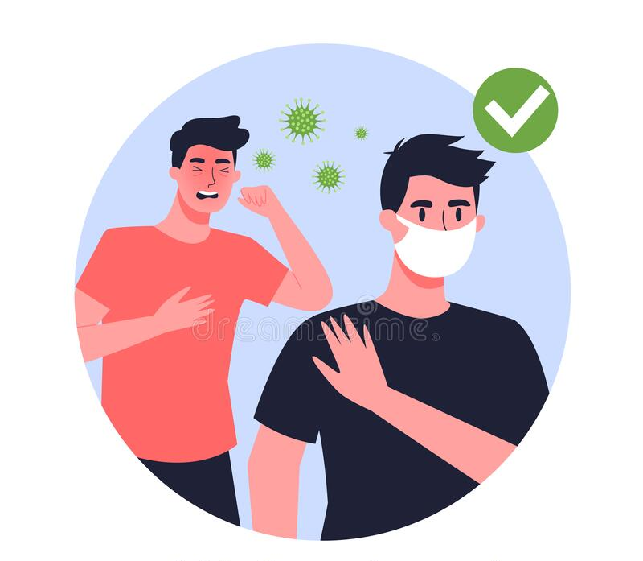
I. NEW WORDS:
1. survive (v)
/səˈvaɪv/
sống sót, sinh tồn
2. survival (n)
/səˈvaɪ.vəl/
sự sống sót
3. shelter (n)
/ˈʃel.tər/
nơi trú ẩn
4. charge (v)
/tʃɑːdʒ/
nạp điện, sạc
5. avoid (v)
/əˈvɔɪd/
tránh xa

Slide 15
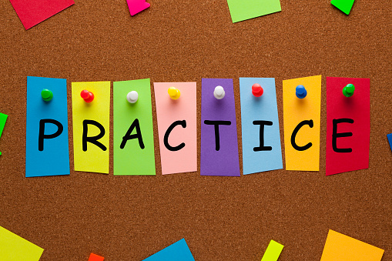

Slide 16

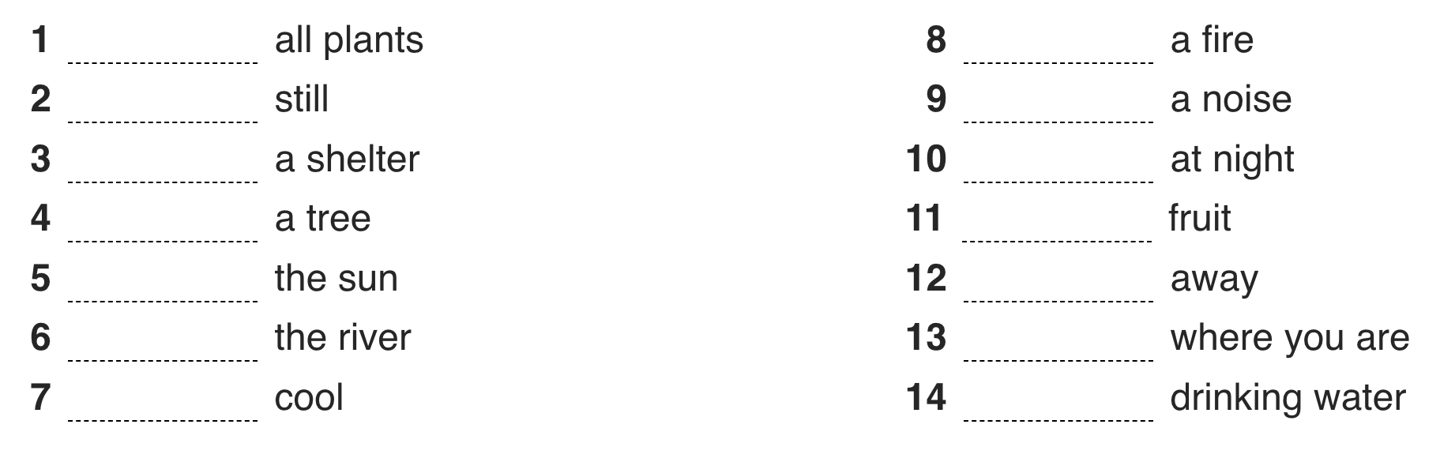
✔ Activity 1: Read the Survival Game and complete phrases 1–14.Then listen and check.
avoid
light
stand
make
build
move
climb
pick
use
run
follow
stay
keep
find

Slide 17
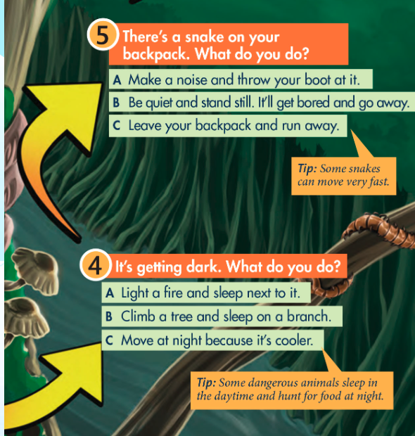
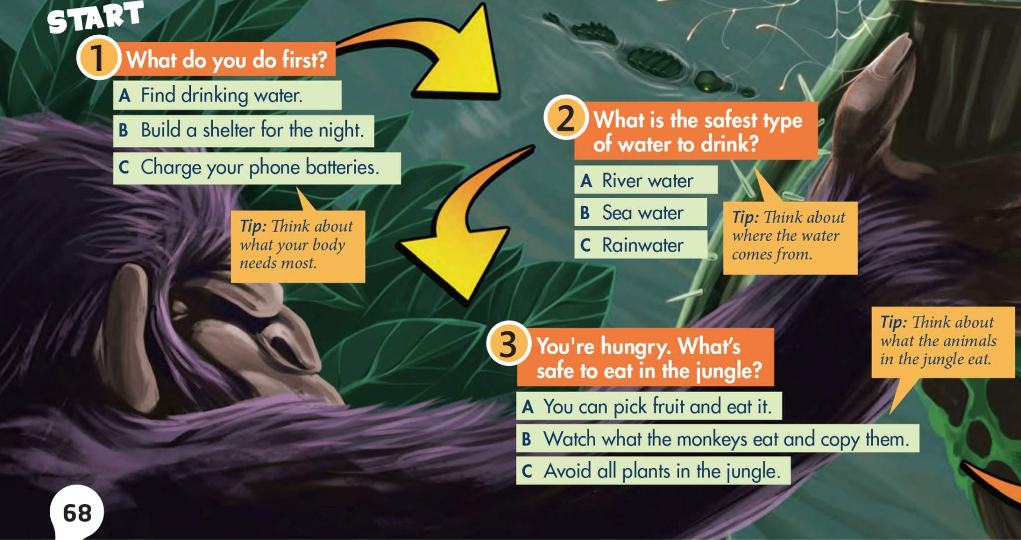
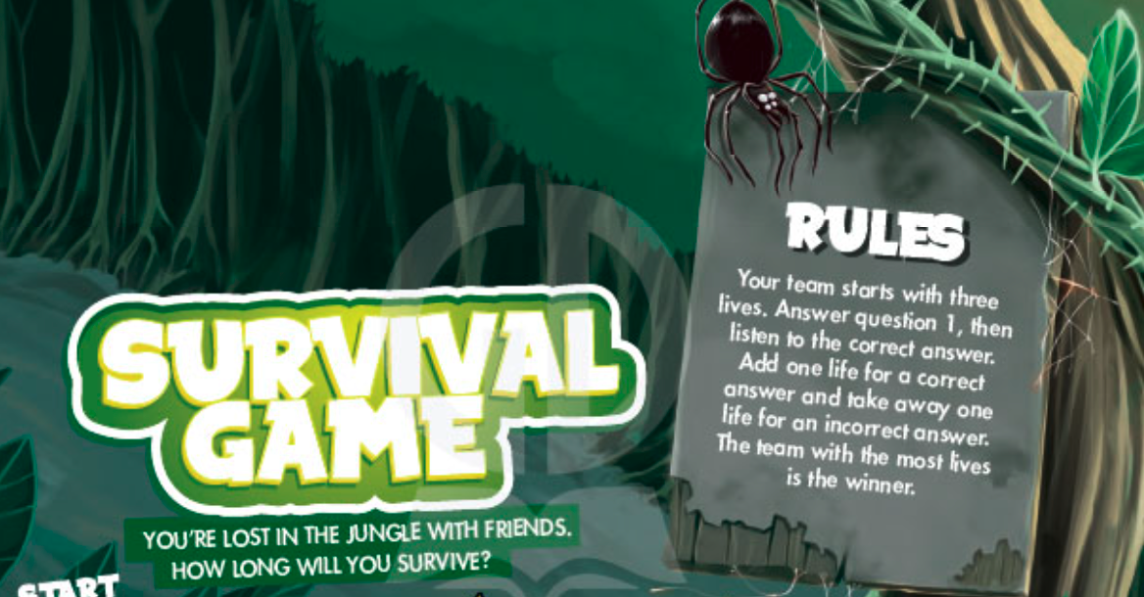
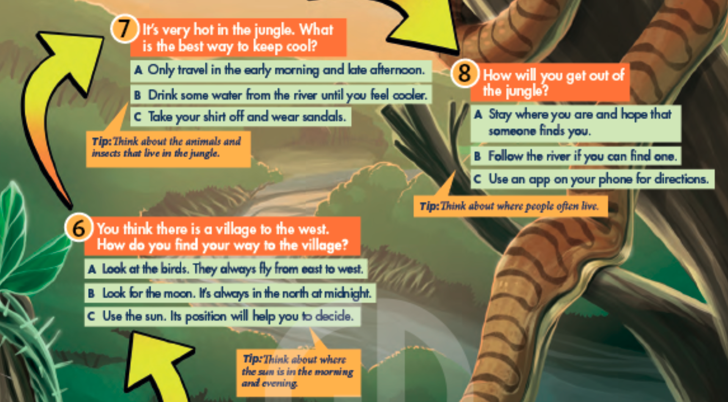
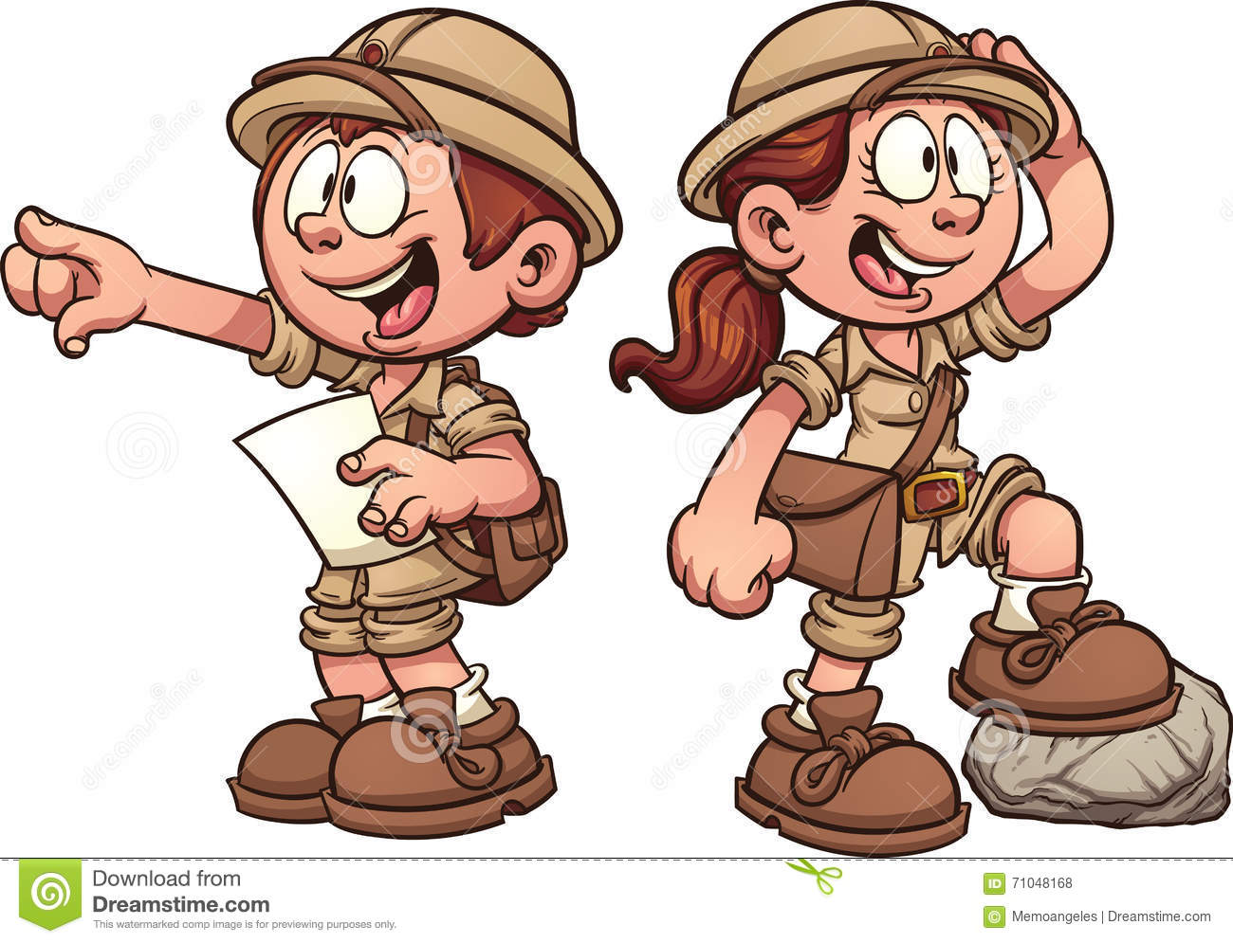
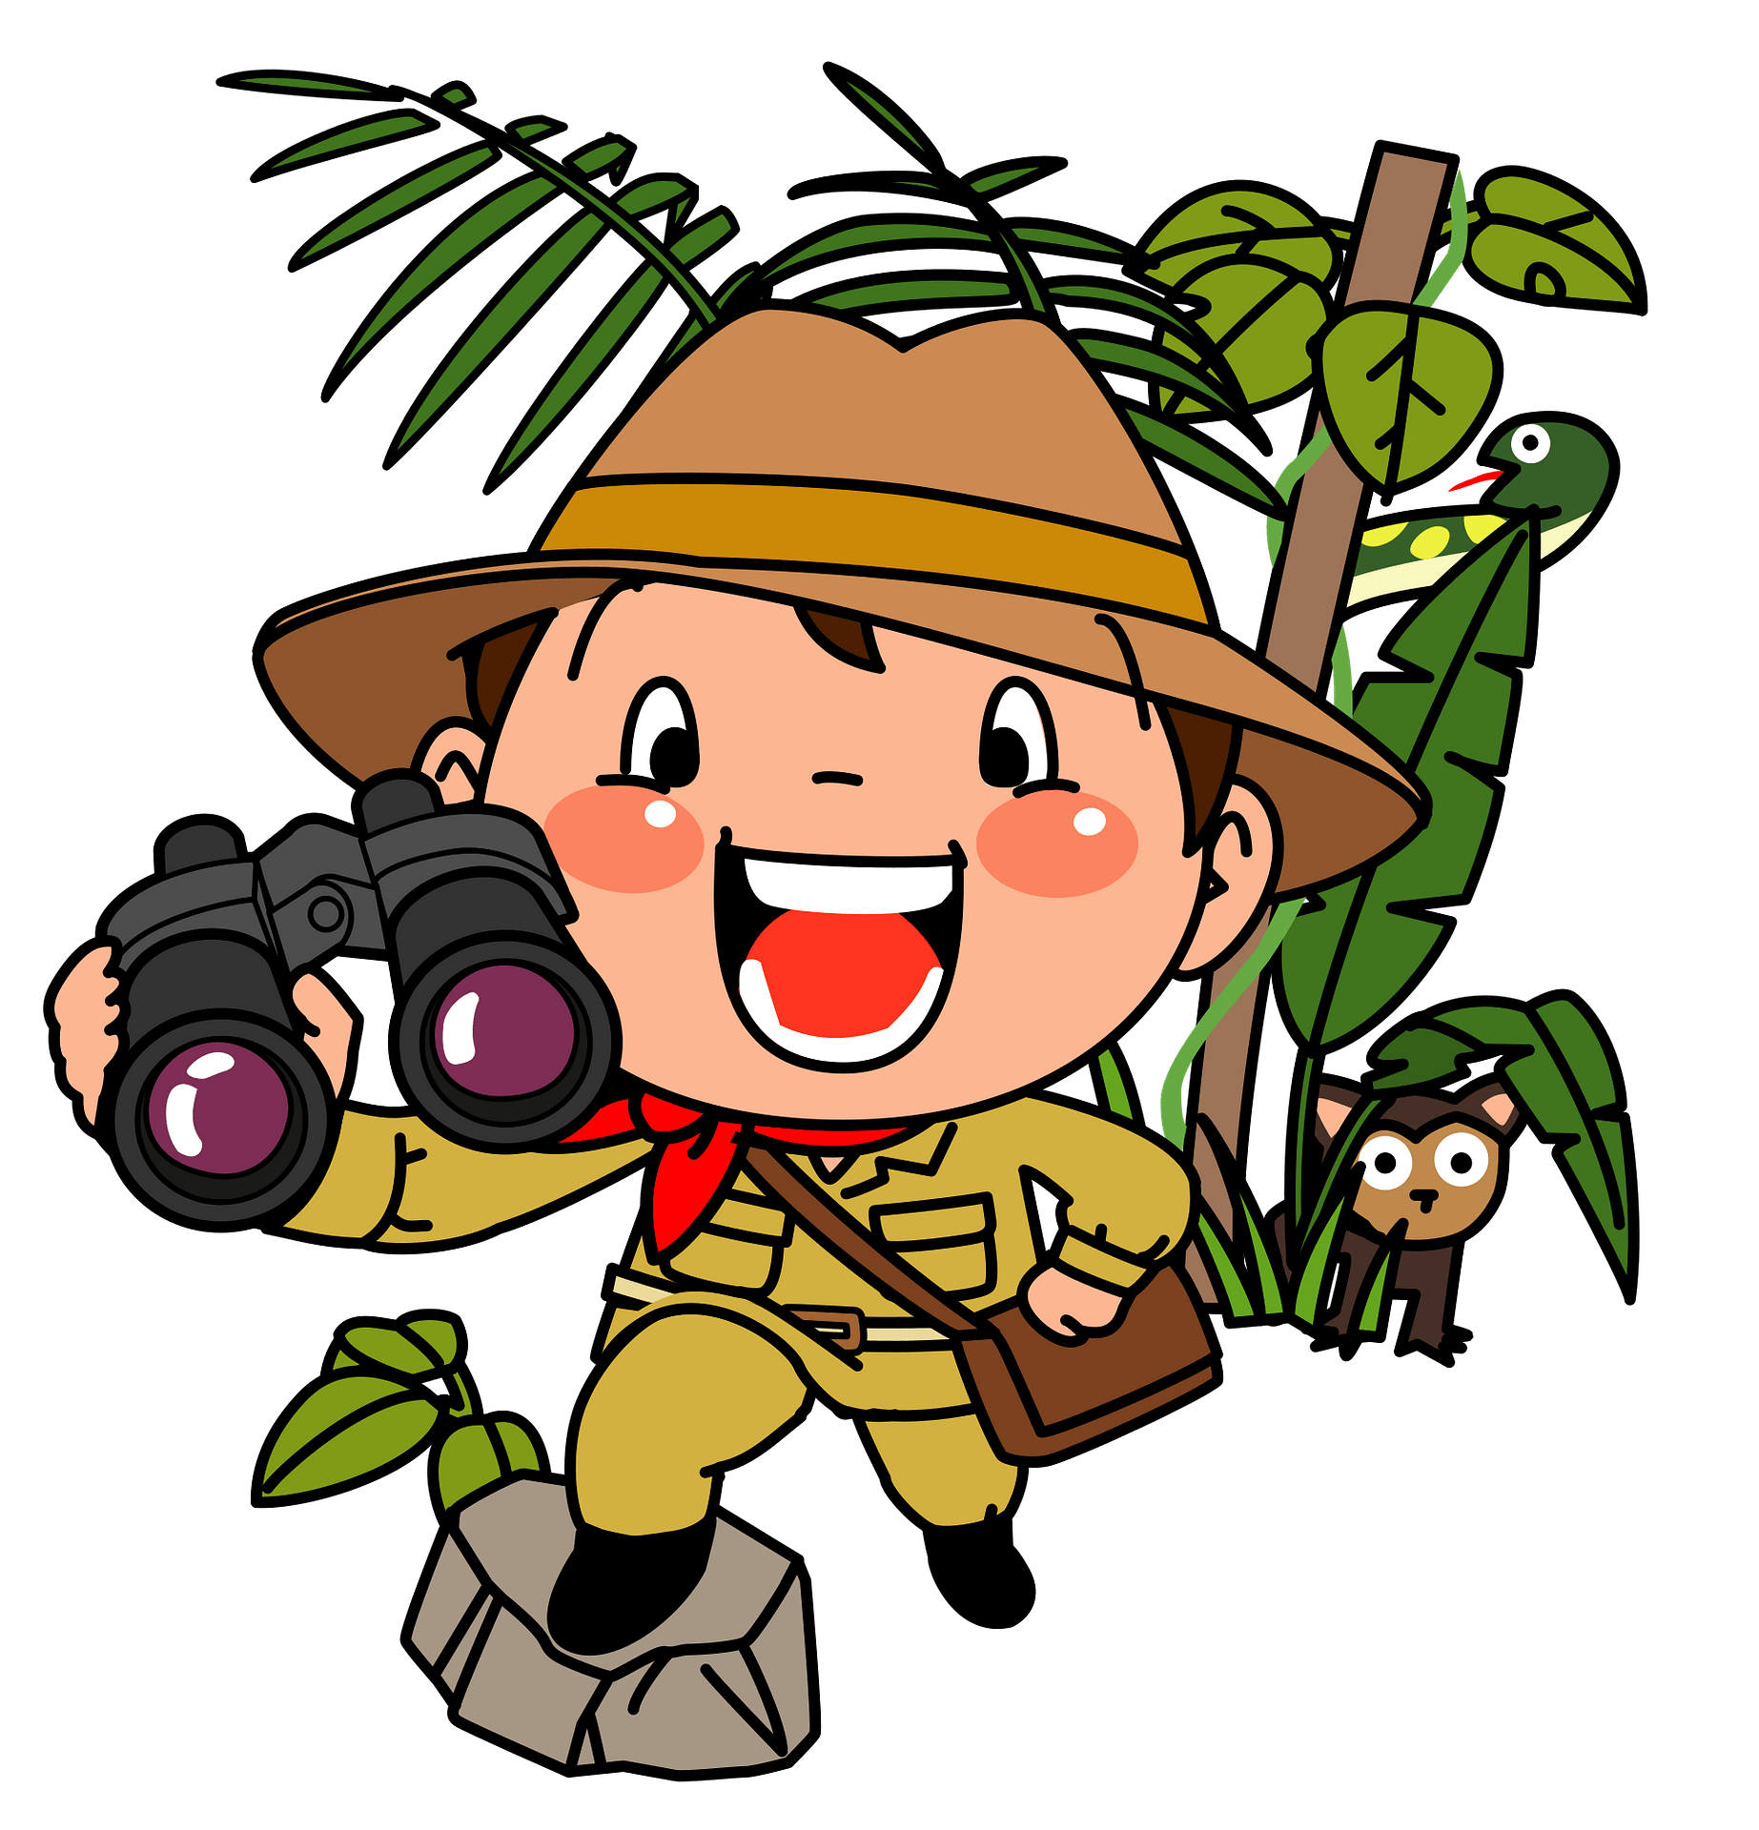
✔ Activity 2: Read the rules. Then play the Survival Game in teams. Listen and check after each question.

Slide 18
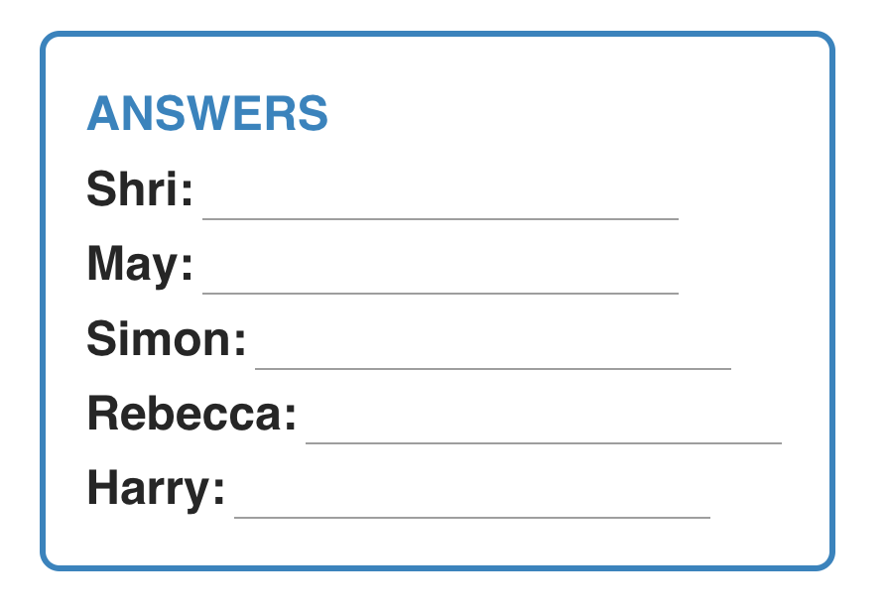
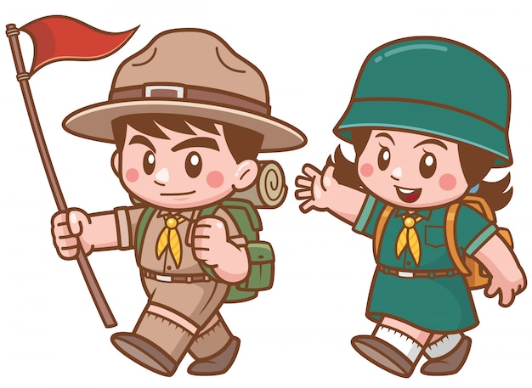
✔ Activity 3: Watch or listen. Which survival skills in the game are the people discussing?
lighting fires
picking fruit
picking fruit
finding your way
finding your way

Slide 19
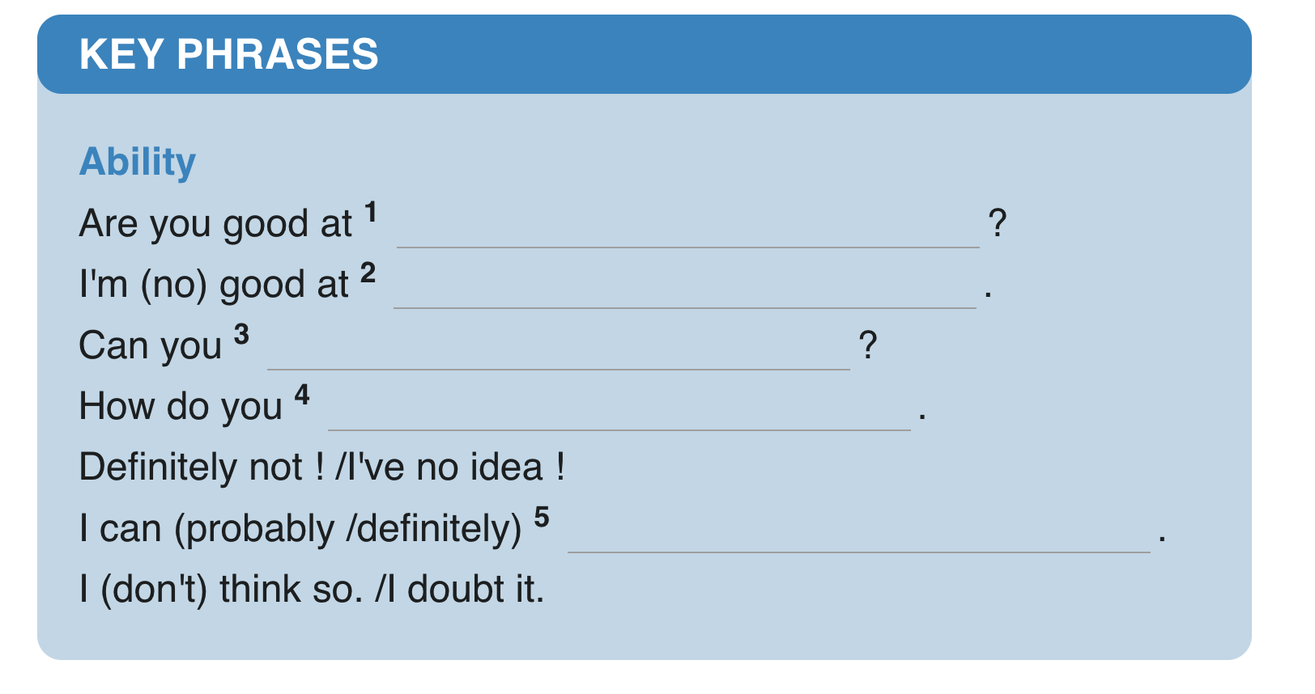
✔ Activity 4: Watch or listen again and complete the Key Phrases.
lighting fires outdoor
survival skills
light a fire outdoor
find your way if you're lost
light a fire outdoor

Slide 20


Slide 21
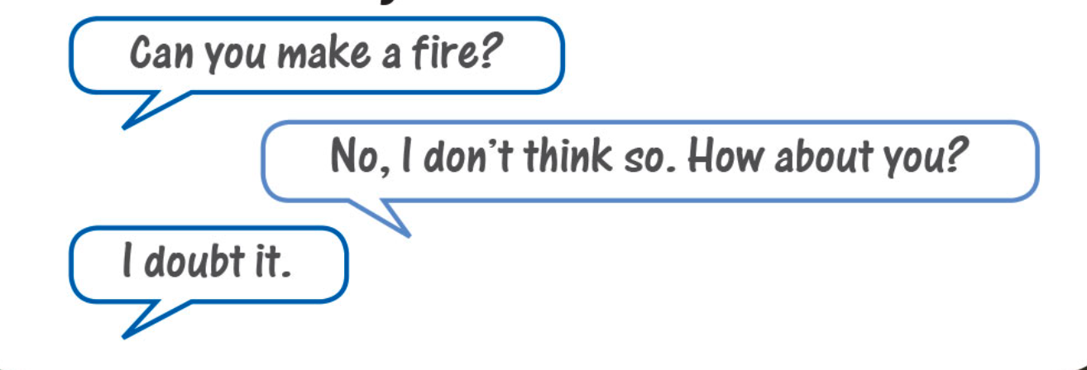
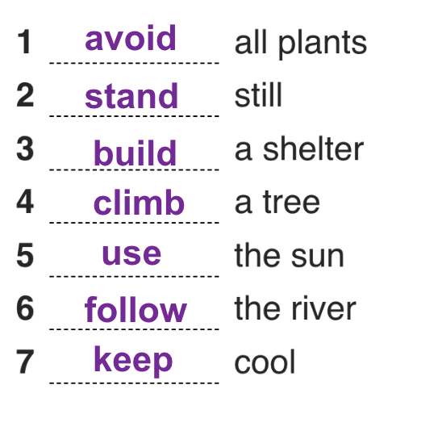
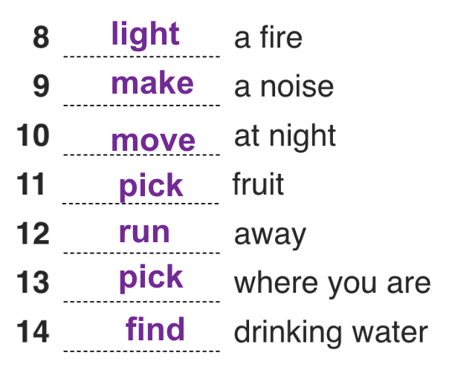
Study the Key Phrases. Then ask and answer the questions about your survivalskills with your partner. Use the phrases in exercise 1 and your own ideas.

Slide 22

- Learn by heart all the new words. - Workbook: Exercises p. - Prepare Lesson 2 – Reading.

Slide 23


